Slide 1
Marketing and Retail Analytics

Slide 2
Quiz- Some basic terms in Retail(1/2)
1. What is a SKU ?
Stock Keeping Unit - SKU' A store's or catalog's product and service identification code, often portrayed as a machine-readable bar code that helps the item to be tracked for inventory. These codes are not regulated nor standardized. When a company receives items from a vendor, it has a choice of maintaining the vendor's SKU or creating its own.
2. What is a UPC ?
The Universal Product Code (UPC) is a barcode symbology (i.e., a specific type of barcode) that is widely used in the United States, Canada, the United Kingdom, Australia, New Zealand, and in other countries for tracking trade items in stores. Its most common form, the UPC-A, consists of 12 numerical digits, which are uniquely assigned to each trade item

Slide 3
Quiz- Some basic terms in Retail(2/2)
3. What does CPG stand for? What does FMCG stand for?
Consumer packaged goods (CPG) are consumable goods such as food and beverages, tobacco, and cleaning products. In general, CPGs are things that get used up and have to be replaced frequently, in contrast to items that people usually keep for a long time, such as cars and furniture. In India and in some other countries CPG companies are called as FMCG companies, which stands for Fast Moving Consumer Goods.
4. What are the 3 most important attributes(variables)that we look at when trying to understand customer behavior ?
What does a consumer buy?
How often does he buy and when does he buy what he buys?
How much does he spend?

Slide 4
Quiz- Some basic terms in Marketing(1/2)
1. What is a campaign ?
2. What is a promotion?
3. What is meant by a “prospect pool”?
4. Can you name some companies that sell data? Why do you need external data sets, when you can get internal data ?

Slide 5
Format Definition
12
Formats
Description
Key categories retailed
Typical size Sq.ft.
Example
A large superstore, combining a supermarket and departmental store, offering full lines of grocery and general merchandise all under one roof
Hyper markets
Food, groceries, apparel, furnishings, consumer durables
15,000-100,000
Big Bazaar, Hypercity, Spencer, Star India Bazaar, Vishal Megamart
Super markets
A large self service outlet offering food and household goods
Food, groceries, medicines
3,000-15,000
FoodWorld, Trinethra, Subshiksha, Food baazar
Convenience stores
Small size, easily accessible stores offering a quick shopping, fast check out experience and extended working hours
Food, groceries, medicines
500-2,000
In&Out
Departmental stores
A large self service outlet offering a variety of merchandise
Apparel, Jewellery, watches, fashion accessories, footwear, furniture, furnishings
10,000-50,000
Shopper’s Stop, Lifestyle, Pantaloon, Westside
Large speciality stores focussed on one or a few categories of merchandise, offering a wide selection at low prices
Electronics, office supplies, apparel
Category killers
20,000-100,000
Best Buy – Circuit City, Staples
Notes:
5

Slide 6
Format Definition (Contd.)
12
Formats
Description
Key categories retailed
Typical size Sq.ft.
Example
Warehouse clubs
Warehouse style large stores, offering goods in bulk at discount prices to members
Food, groceries
100,000 +
Metro cash and carry, Costco, Sam’s Club
Single brand outlets
Retail outlet offering products of a single brand
Apparel, footwear, tyres, food services, furniture
1,000-5,000
Nike, Adidas, Colourplus, McDonalds, Gautier, Gucci, TBZ
Multibrand speciality stores
Retail outlet offering multiple branded products belonging to a single category class
Footwear, apparel, electronics, books
1,000-20,000
Planet Sports, Planet Fashion, Crosswords
Notes:
6

Slide 7
Why an Analytics Health Check is necessary ?
Most Analytics consultancies do an Analytics Health Check of the organization that they consult to gauge how much awareness exists within the firm and how much needs to be built.
Let us do a quick Analytics health check for ourselves and see where we stand !!

Slide 8
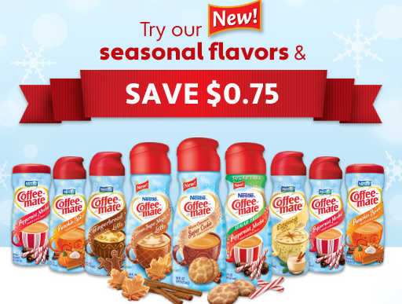
Targeted Marketing – You have a budget for targeting shoppers in Spencer. Prepare a marketing analytics strategy for each of these two options?
Send coupons to customers who shop in your top 10 stores
Send coupons to customers who are your top 100K shoppers across 100 stores
Notes:
Why obvious response – it is the easiest thing to do !
What are the roadblocks to getting a desired response ?

Slide 9
Top 10 stores visa-vis top 100k shoppers
Top 10 stores
On what basis do you identify your top 10 stores ?
Rank stores by revenue ?
Rank stores by margins/profits?
Rank stores by number of goods sold ?
Rank stores by some other metric ? (Revenue per sq. ft)
Top 100k shoppers
On what basis do you identify your top 100k shoppers ?
A person who buys a TV for Rs.100k but visits only once a year, or a person who visits every week, but spends only Rs.10,000 ?
Not just the top 100k shoppers but top 100K shoppers who are either buyers of this brand or this category- what if there are not enough shoppers who buy into this brand ?
Proxy brand

Slide 10
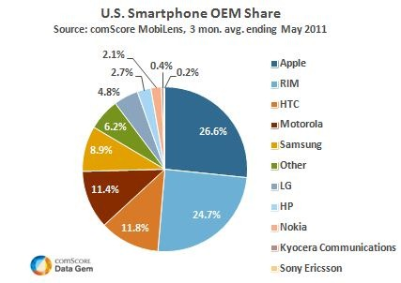
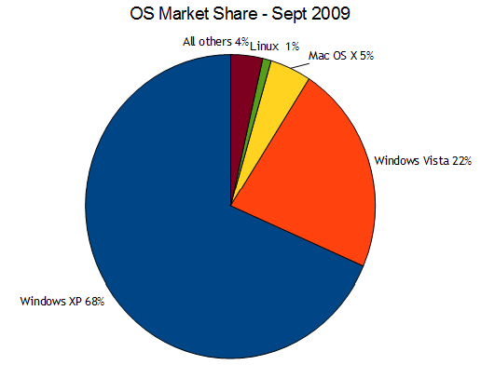
Grow top line through Marketing
Focus on growth of your market share through mass marketing – a la Microsoft
Focus on growing the spend from existing customers
- a la Apple
Notes:
Microsoft strategy has been to grow market share through muscle
Apple grew its market share through increasing the share of wallet of its existing customer base of Apple devices
People who use Apple devices are hooked to them for life- Apple’s story about its loyal customers is now legendary

Slide 11
Mass marketing versus growing share of wallet of existing customers?
Focus on growth of your market share through mass marketing
How do you calculate the market share ?
Syndicated data- IRI, Nielsen, IMRB
How do you increase market share ?
- mass advertising
- new customer acquisition through campaigns
Focus on growing the spend from existing customers
How do you calculate the share of wallet of your customers ?
How will you get data about what your customers are buying from other stores ?
Can you use Analytics to use share of wallet numbers for a small section of your customers and extrapolate to the rest of the population ?

Slide 12
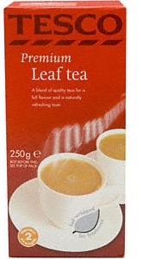
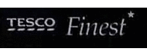

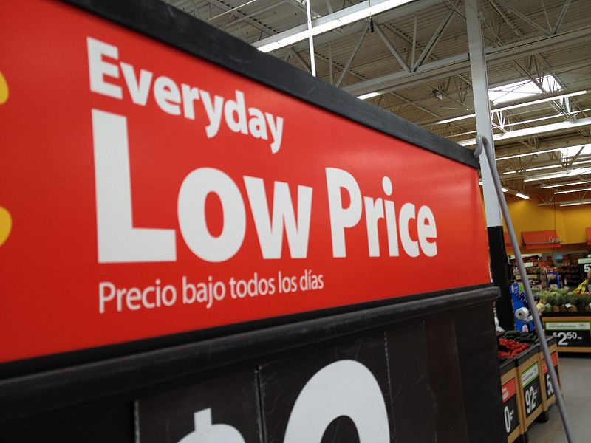
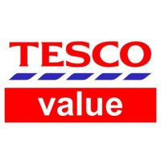
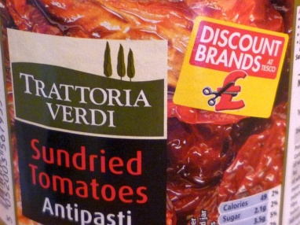
Would you try and beat your competitor on price for key products as compared to adopting a low price strategy for items that are bought by price sensitive customers ?
Every Day low price for many key products
Reduce price of items that are bought by price sensitive customers

Slide 13
Through these Caselets we have covered some important concepts- Can you define them in simple terms ?
Targeted marketing
Share of wallet
Price sensitive customers – Pricing segmentation

Slide 14
Customer Loyalty
How would you define customer loyalty?
Customer loyalty means different things to different people, but the following questions best summarize what Retailers are looking for when they want to understand customer loyalty.
“Who are the best customers of the Retailer?”
“How much of the Retailer’s business is reliant on these customers?”
“How well is the Retailer meeting the needs of these customers?”( Does the Retailer have the right range and assortment of the products that the customer wants and at the right price points)
“How can the Retailer reward these customers ?“
Some common applications of a loyalty segmentation are:
Prevent defection of the most valuable customers by keeping them engaged and rewarding them often
Re-activate customers who have become less loyal by re-engaging them with exciting offers
Increase the loyalty of less engaged customers through personalized and relevant targeting
Target campaigns at a local level, by understanding regional and store level differences
Notes:
- Application of segmentation is to engage customers and reward them often, help in carrying out targeted marketing strategies.

Slide 15
Consumer Analytics
The most important aspect of Analytics in Retail is to gain a very comprehensive understanding of the consumer
The key to understanding consumer behavior is through building different kinds of segments :
1. RFM :- This segmentation technique gives you a measure of the loyalty of the customer. ( Should be refreshed at least once in a quarter as there movements across segments in shorter time frames).
2. Consumer Lifestyle Segmentation:- Run a cluster Analysis on the consumer level data of Retailers to arrive at this segmentation. ( How many segments are recommended ?)

Slide 16
Actions to be taken using RFM segments
Super-Savvy
Savvy
Diligent
Intermittent
Lapsing
Lost
Devoted
Potential
Borderline
Incentivize & Preserve
Expand & Nurture
Re-acquire
A targeted communications strategy will drive required behaviour from all customer groups

Slide 17
Collapsing the RFM segments

Slide 18
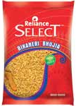
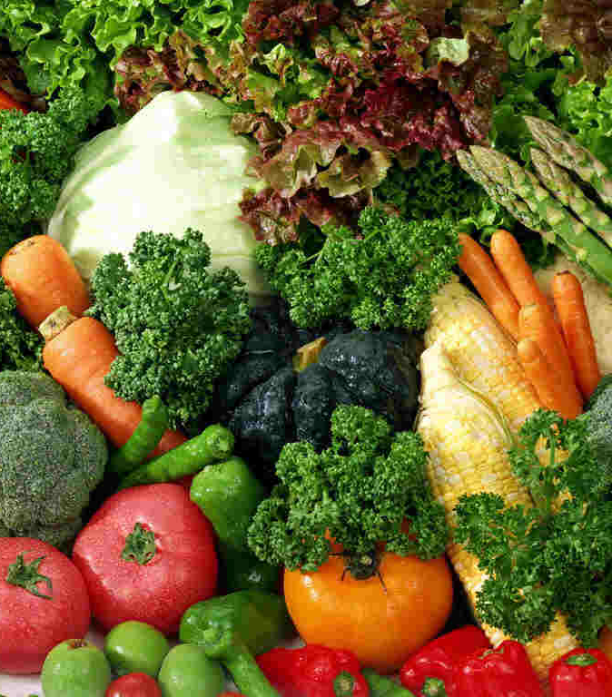
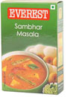
Products are categorised using Customer Lifestyle Attributes
Segmentation
Each product is categorised using a series of attributes
Low Price
Reliance Own
Reliance Select
Fresh
Unpacked
Conventional
Branded
South Indian
Quick
Top products that account for 95% sales are flagged with such attributes
We look for the balance of key attributes in each customers shopping …

Slide 19
Can you come up with 50 pre-identified Customer Lifestyle Attributes for Reliance Retail ?
We make use of over 50 attributes for profiling customers who then can be grouped into 6 to 12 more manageable high level Lifestyles segments. The numerous dimensions give us a deeper understanding of particular shopping behaviour of various customer groups.
For example we can easily identify customers who have a tendency to buy into large non-food items (electrical etc). This will be used in targeting for Reliance Digital.
Basic Cooking
Branded
Chinese
Collection items
Conventional
Experimental
Exotic
Fresh
Halal
Healthy
High Calorie
High price
Hygiene
Imported
Instant
Italian
Jain
Kids
Long-life
Low Fat
Low price
Non food - All
Non food - Essentials
Non food - Kids
Non food - Perishables
Non food - Value added
Organic
Pre packed
Ready to Eat
Reliance Dairy Life
Reliance Dairy Pure
Reliance Healthy Life
Reliance Premium
Reliance own label
Reliance Select
Reliance Value
Serve One
Small pack
South Indian
Supplements Alternative
Thai
Unpacked
Value pack
Vegetarian lenient
Vegetarian pure

Slide 20
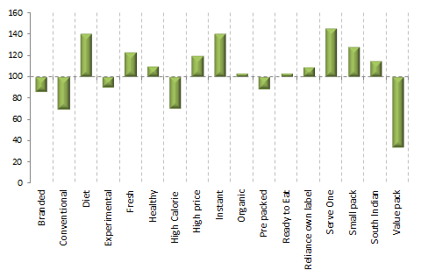
These dimensions make up each customers ‘Lifestyles DNA’ or persona
Segmentation
We study product attributes of all items in your basket
We can then see when you are frequently buying products with the same attribute
We then compare you to the Rest of Reliance shopper to see where your purchasing behaviour is most extreme
This customer buys a lot of items that are ‘Instant’ and ‘Serve One’

Slide 21
Customer Life segments
Segmentation
Price sensitive
Bargain Hunters • Heavy users of discount coupons and offers • Value driven buyers who often end up with the lowest priced items • Don’t like to experiment with their shopping list, stick to a limited product range • Price is the most important factor in their shopping decisions
Economy Spenders • This group goes for value for money product combos and bulk packs • Buy pre-packaged cereal and dals from Value range but not a lot from the fresh range products.
Conventional
Conventional • The most traditional customer group • They don’t like to buy in bulk, shop frequently but have smaller baskets • Know what they want and stick to it • They tend to be older and buy conventional food items
Predominant
Typical Brands • Regularly buy similar items, mostly traditional meals • Not big spenders, but buy popular brands that are tried and tested rather than own label products
Controlled by Kids • Families where kids who dictate shopping list • This customer group visit the store frequently • They need to buy lots of Non-food items for kids, so prefer to have everything at one store • Their baskets are larger and they are more inclined towards promotions
Nutrition First
Wholesome Living • Relatively older shoppers who don’t experiment much • Stick to traditionally healthy habits of eating • Don’t fret about calorie count • Buy wholesome nutritious foods
Calorie Conscious • Usually working couples with no kids • Tend to be health conscious and buy low-cal items • Unlikely to buy anything with high fat or high calories • May have an inclination towards organic product range
No Time for Kitchen
Too Cool to Cook • Younger adults, living away from family, mostly with friends • Like to spend their time at work/on activities rather than in kitchen • Often pick up quick and/or ready-to-eat meals
Busy Connoisseurs • Young professionals who enjoy fine food but can’t make time for cooking • Buy wide range of food items on-the-go • Prefer to shop for Grocery and Non-food at one single place for convenience
Delicatessen Diners
Gourmet Lovers• This customer group has developed a palette over time • They are well travelled and know their food • Tend to be slightly older adults who enjoy cooking • Don’t hesitate in venturing out to specialist stores •
Global Organics • Environmentally conscious customers who buy lots of organic foods • They are often experimental cooks who like to cook from scratch • Influenced by non-conventional cooking techniques
Experimentalists • First ones to try novel and exotic things • Appreciate fine food and like to cook at home as well • Buy from a wide range of food.

Slide 22
Most frequent complaint from clients/stakeholders- we get tables, charts and models but little insights and recommendations
1. Look at the different elements of your data and think how it is useful for a retailer
2.Does he want to know more about his stores and how they are performing ?
3. Will he be interested in knowing consumer behavior ?
4. Which categories are doing well and which categories are not ?
5. Which brands are doing well in my stores and which are not ?
6. Analysis using the data
Store level ( build it with the class)
Brand level
Category level
Customer segment level

Slide 23
Create Insights and prepare a dashboard from the loyalty data set
Enterprise level dashboards
Store level dashboards
Consumer level dashboards
Vendor dashboards/scorecards

Slide 24
Survey – some points to remember
Establishing the Aim(s) of Your Research
If your research is too broad, you will have to ask too many questions; too narrow and you will not be researching the topic thoroughly enough
Determining Your Sample Group
Random selections from a stratified sample
Pure random sample (utopian in a large data scenario)
Methodology
Face to face
Mail

Slide 25


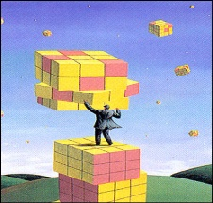

Direct Marketing Life Cycle without Analytics
Campaign Brief
Campaign Planning, Scheduling and Documentation
Campaign Details
DM Costs
Post Campaign Expectations
Random Population selected based on availability of budgets
No selection criteria used
Anyone in the prospect pool can get an email
Carpet bombing of a million customers
No tangible return on investment
Exhausted your marketing budget as per plan
A very happy boss- you have covered most customers !!
Danger of repeating the same promotional mail to a prospect within X months again and thus violating US state laws
Learnings from campaign lost
No Analysis of campaigns done
Mail House Intimation

Slide 26
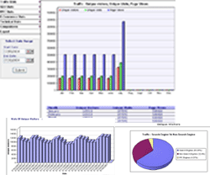
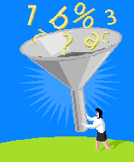
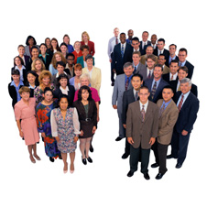
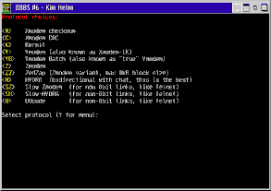
Direct Marketing Life Cycle with Analytics embedded
Campaign Brief
Campaign Planning, Scheduling and Documentation
Campaign Details
Targeting Details
Target Audience
DM Costs
Post Campaign Expectations
Files Selection Process
Program Brief
Program Timelines
Mail File Delivery Channels
Point of Contacts
begins
Strategy
Suppression
Optimized budget spend
High conversion rate
Quantifiable ROI
Improvement of next campaign
Campaign Tracking
Direct Marketing
Legal Compliance
Privacy
Solicitation History
Response/Statistical Models – Create Deciles
Selection Strategy
Mail House Intimation
Mail File Cutting and Shipping
Segmentation Design of Experiments

Slide 27

Thank you!

